Slide 1
HTTR – accessing the web with R
Notes:
Welcome everybody to the 3rd meeting of the R user group. Thank you everybody for coming along, and big thanks to Johan and Michael for asking me to speak today.
I am going to be showing you how to access data stored in online databases using R. Specifically we will use the pubmed database to find out how many papers were published containing a certain keyword each year.
This way of accessing data can be extremely useful. This can often allow you to access more data, in a greater range of formats than directly through a website. Can allow you to access subsets of data without neccassarily downloading all of the data, particularly useful when working with large datasets such as NGS data, 1000 genomes and possibly in the future the 100000 genomes. At times this also allows you to benefit from the severs computuational power to generate sets of data which would take much longer on our personal PC.
To start off with I am going to cover some of the basics of transferring information over the internet.

Slide 2

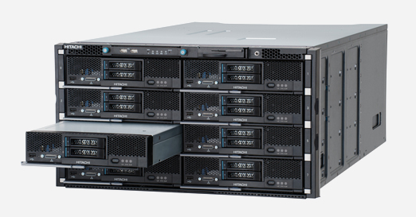
Accessing information over the internet
The internet
Client
Server
HTML files
Documents
Data
Computing capability

Slide 3
HTTP
GET
PUSH
PUT
DELETE

Slide 4
404 not found

Slide 5
Many sites offer access to the information online:
Eg. 1000 genomes, pubmed, local weather, twitter
Pubmed:
A General Introduction to the E-utilities - Eric Sayers

Slide 6
HTTR package
Httr is a package to interact through http protocol.

Slide 7
Live coding
httr
XML
xml2

